Slide 1

IOD Mini Project 1
WEATHER-X Presentation
8 August 2020
By Rick K Nguyen

Slide 2
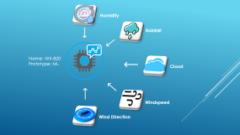

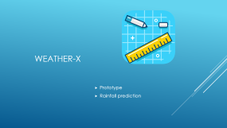

Project Weather-X

Slide 3

Weather-x
Prototype
Rainfall prediction

Slide 4
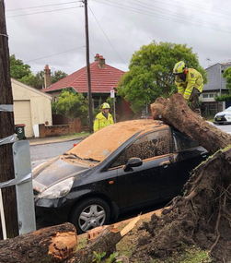
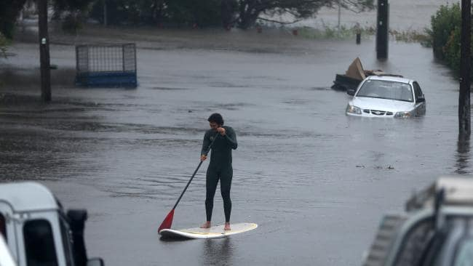
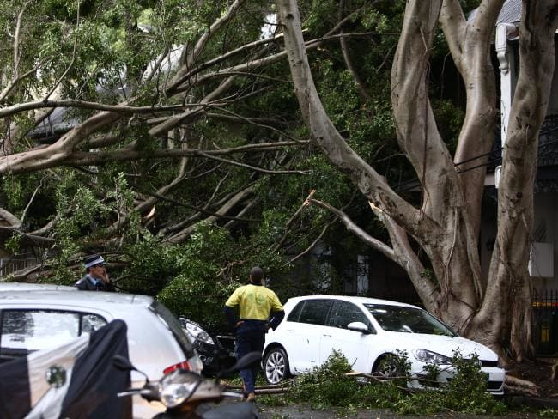
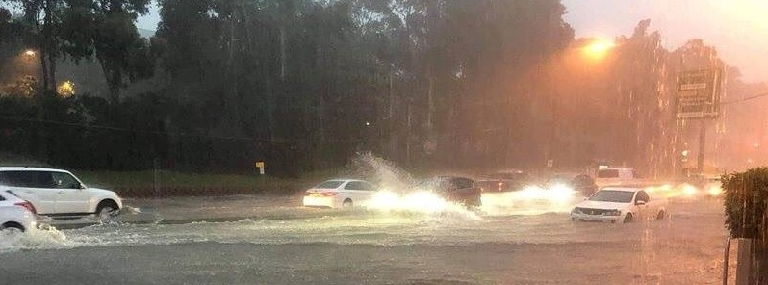
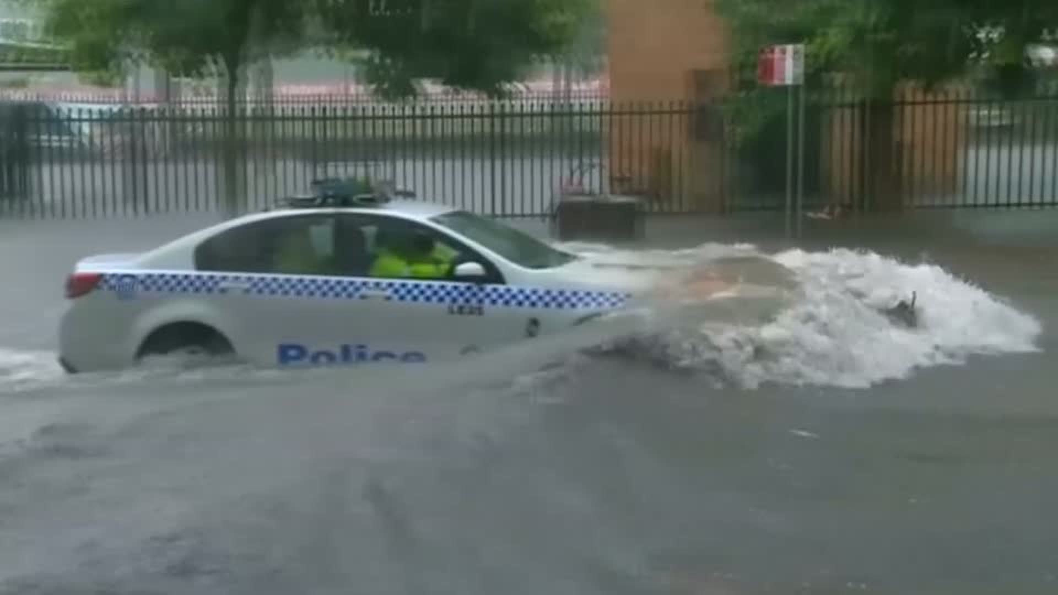
28 November 2018
Wettest day since 1984
105 mm rainfall in 2 hours
500 calls for assistance
12 flood rescues
Downed power lines
2 fatalities

Slide 5
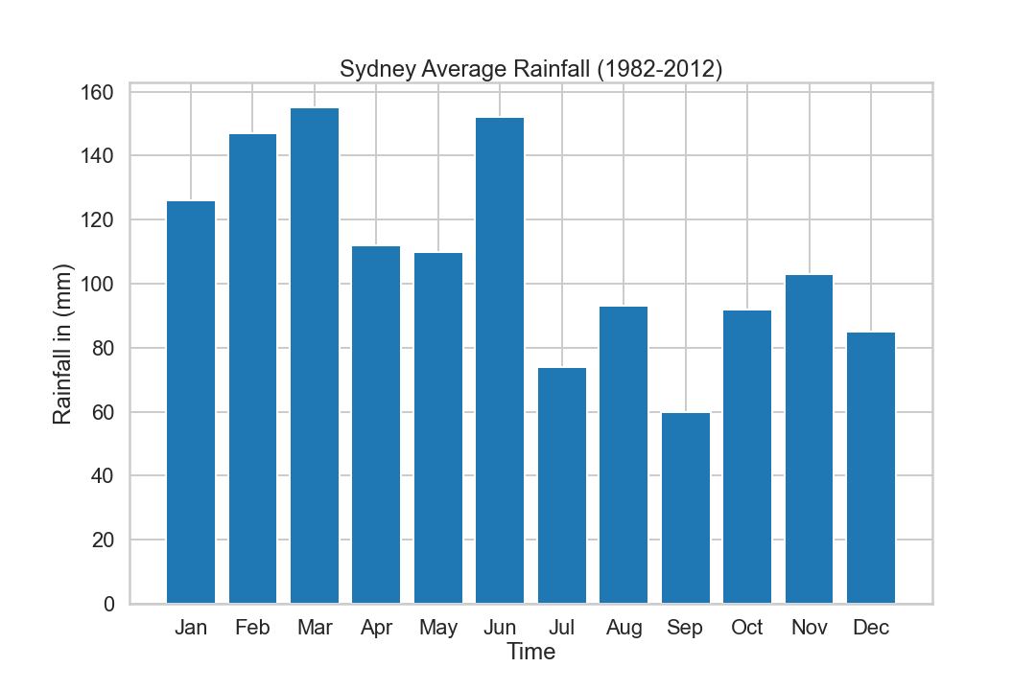

November average was 103 mm
The data was accurate to show average per month. However, they did not expect the rainfall to fall within 2 hours.
Hence, the needs for effectively predict the rainfall amount for the next day.
BUSINESS: What is the amount of rainfall in mm for the next day.
BENEFIT:
Plan ahead, evacute, protect property
Manage workflow of SES, Ambunlance, police
Save operation cost for services.
103 mm

Slide 6

what is the amount of rainfall in mm for tomorrow?
Due to the incident, Can we predict the amount of rainfall for the next day
IN OTHER WORDS,

Slide 7


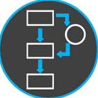

Pipeline
1.Gather data through our allocated sensor and system
2.Process these data
3.Feed these data into WeatherX
4. WeatherX provide output
5. What kind of data do we need
Humidity at 3pm
Cloud formation
Evaporation
Windspeed
Data
Result
Analyse
Machine Learning

Slide 8







Humidity
Rainfall
My prototype can affectively predict the exact amount of rainfall for the next day.
Now imagine what we can achieve if this is true ?
Think about the benefit on RFNSW(we can effectively allocated funding, manpower, assistance to those in needs
It can also benefit private sector like aviation, aricultural.
Now that u have the underdstanding of this project. I will take you to how it work
Name: WX-820
Prototype: ML
Cloud
Windspeed
Wind Direction

Slide 9
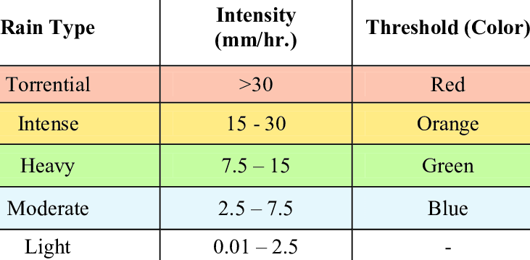
Model & Prediction
Humidity: 22%
Rainfall: 20mm
Cloud formation: 5 oktas
Wind speed: 44km/h
Wind direction: SSE
Prediction: 51.86 mm

Slide 10
Future Objectives - Public & Private Sector
Government funding to FRNSW 2019/2020 774 million
World Bank Group estimates that improved weather forecasting would result in increases in productivity worth $30 billion per year, as well as reducing asset losses by $2 billion per year
Reduced overall fuel consumption, saving $30 million per year.

